Slide 1
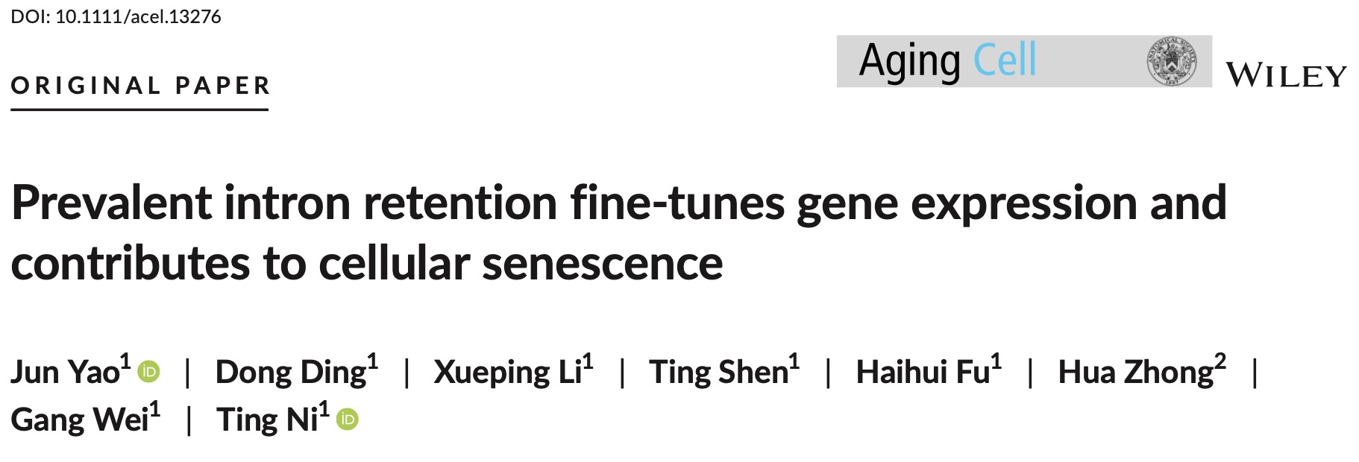

中南大学清新大气PPT
GENERAL REPORTING TEMPLATE FOR CENTRAL SOUTH UNIVERSITY
1State Key Laboratory of Genetic Engineering, Collaborative Innovation Center of Genetics and Development, Human Phenome Institute, School of Life Sciences, Fudan University, Shanghai, P.R. China
2Department of Population Health, NYU Langone School of Medicine, New York, NY, USA
Correspondence
Gang Wei and Ting Ni, State Key Laboratory of Genetic Engineering, Collaborative Innovation Center of Genetics and Development, Human Phenome Institute, School of Life Sciences, Fudan University, Shanghai 200438, P.R. China.
Email: gwei@fudan.edu.cn; tingni@fudan. edu.cn
Notes:
IR 变化与相应基因的表达改变呈负相关， 并有助于衰老相关的表型，扩展了 IR 的生物学意义

Slide 2

背景
01
细胞衰老（ Cellular senescence ）：连续增殖后细胞周期停滞
衰老细胞特点：细胞形态会扁平和扩大、增殖率降低、肿瘤抑制因子和DNA损伤标志物的高表达
细胞衰老被认为是衰老的关键标志之一，也是导致老化和年龄相关疾病的重要因素
转录组和/或蛋白质组的变化与衰老细胞的表型改变有关，在衰老和老化过程中都发现了广泛的 AS 变化
AS的失调与人脑老化，阿尔茨海默病易感性有关。
知行合一、经世致用
自强不息 厚德载物
Central South University
Notes:
老化和细胞衰老这两个术语不能互换使用。老化是随时间推移的进行性衰退（人变老），而衰老在整个生命周期中都可发生，包括胚胎发生期间。
细胞衰老涉及胚胎发育、组织退化和癌症预防 这些研究证明了细胞衰老很重要，且与AS 有关

Slide 3
背景
01
内含子保留（IR）是基本的 AS 模式之一
IR可能会抑制肿瘤抑制基因的表达
IR是癌症新表位的新来源
IR 表达升高是衰老过程中的一个分子特征，并且还与阿尔茨海默病有关
知行合一、经世致用
自强不息 厚德载物
Central South University
Notes:
新抗原/新表位（neoantigen/neoepitope）

Slide 4
背景
01
RNA 结合蛋白 (RNA-binding proteins，RBP)，尤其是剪接因子，参与 IR 调控
许多 RBP 在老化组织中表现出动态表达变化，有些RBP与细胞衰老密切相关。
然而，
IR的动态变化是否对衰老起因果作用，
哪一些RBP调控全局IR和衰老尚不清楚。
知行合一、经世致用
自强不息 厚德载物
Central South University
Notes:
剪接因子参与RNA前体剪接过程的蛋白质因子。根据其功能作用，可以分为核小核糖核蛋白颗粒(snRNP)蛋白因子和非snRNP蛋白因子 这论文就是讨论的这两个问题

Slide 5
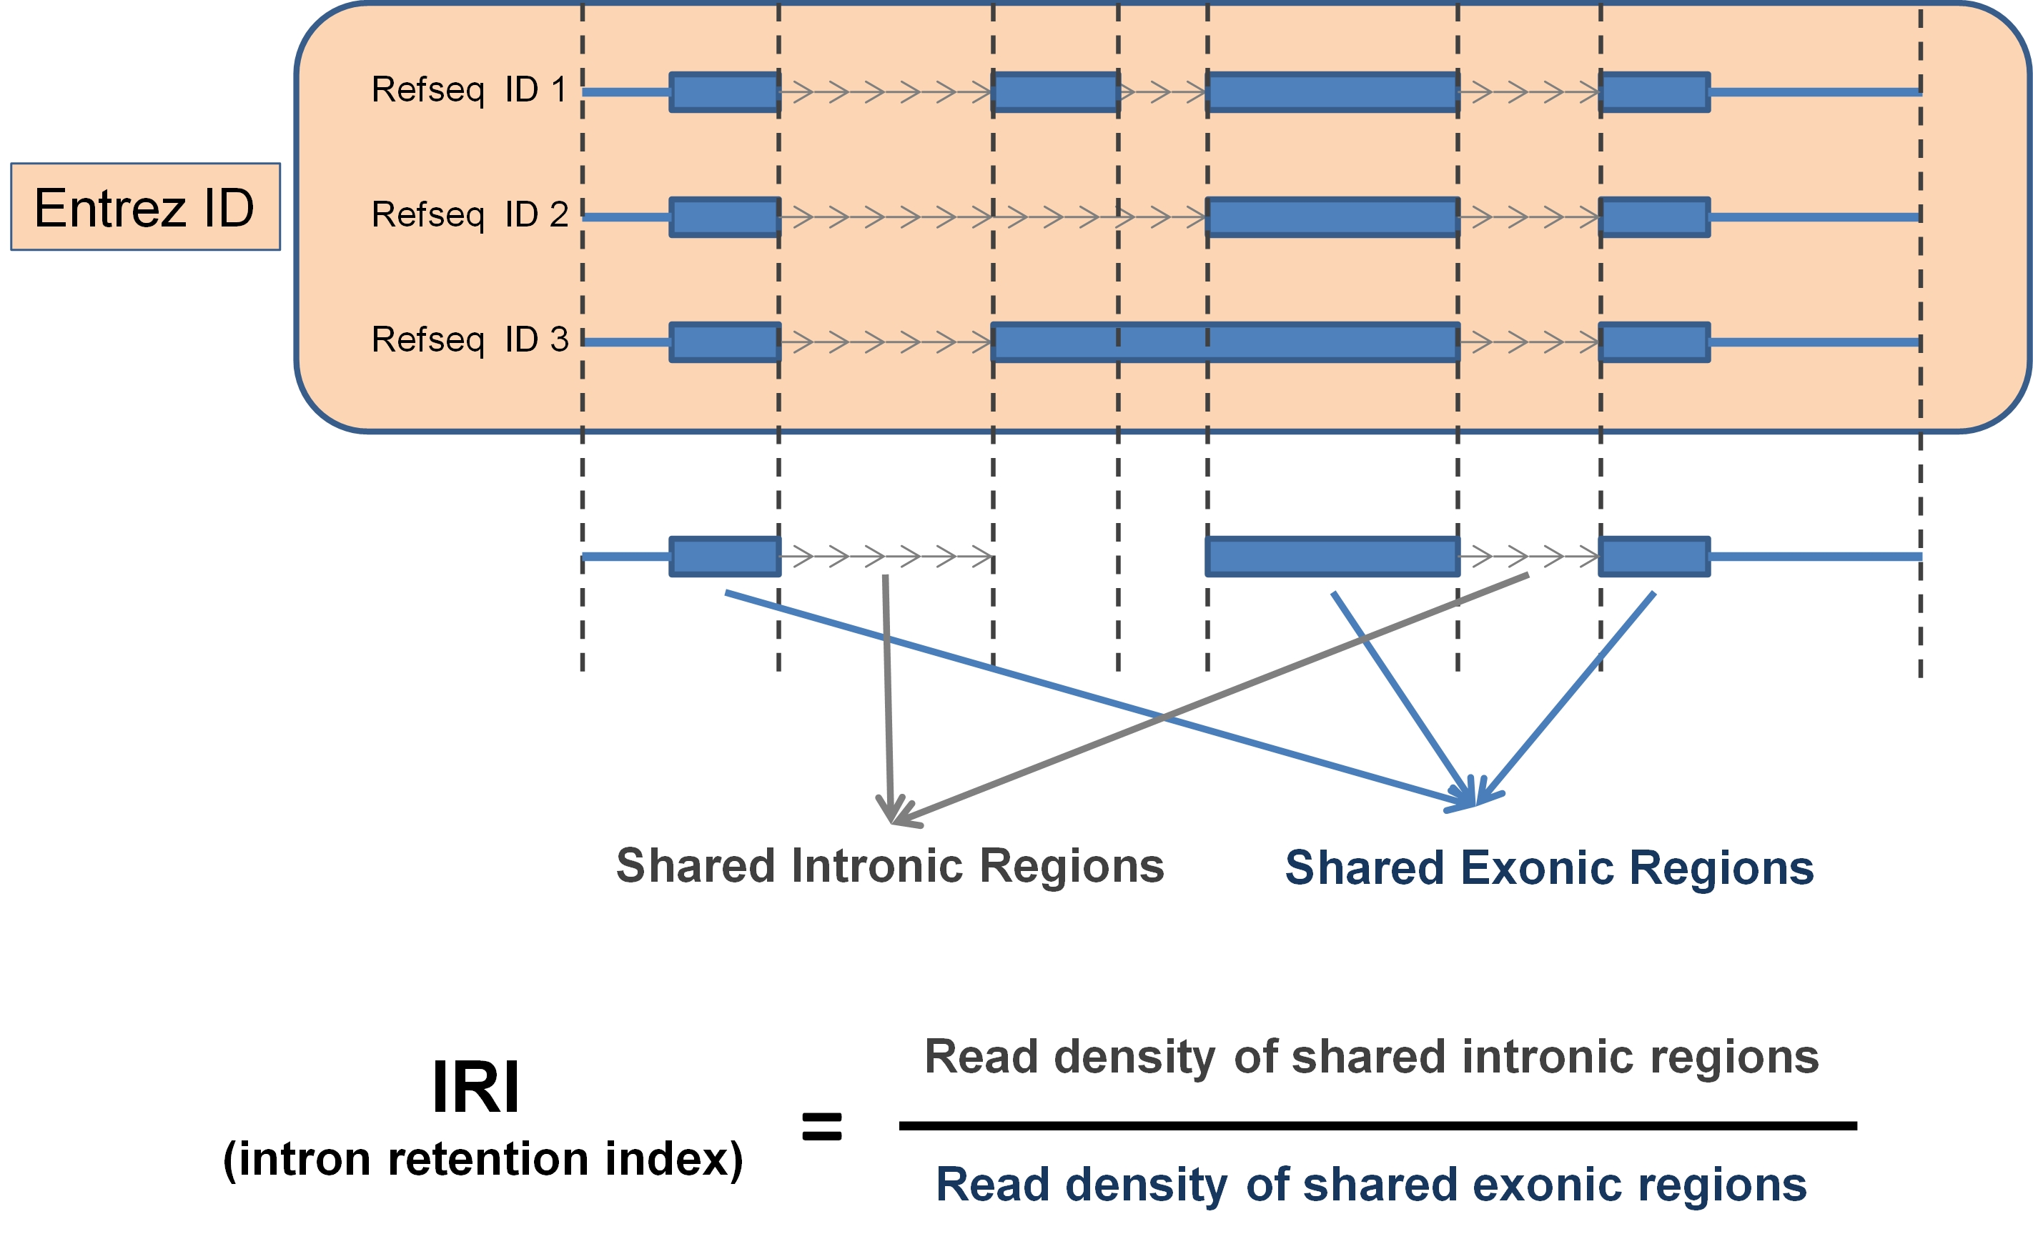
方法
02
independent Intron: was extracted from the RefSeq gene annotation file downloaded from the UCSC
transcript isoforms
知行合一、经世致用
自强不息 厚德载物
Central South University
Notes:
intron retention event was applied a retention cutoff of 10%, i.e., IRI ≥ 0.1

Slide 6
方法
02
• Intron with IRI <0.1 across all time points (i.e. max(X) <0.1) were defined as constitutively spliced introns (no_IR);
• Intron with max(X)−min(X) <0.1 were defined as no significant change in IRI (stable_IR);
• Intron with max(X)−min(X) ≥0.1 and Cor(X, L)>0.7 were defined as continuous up (up_IR);
• Intron with max(X)−min(X) ≥0.1 and Cor(X, L)< −0.7 were defined as continuous down (down_IR);
L=[0, .., 1] (difference =1/(n-1) )
知行合一、经世致用
自强不息 厚德载物
Central South University
Notes:
两种数据集：five population doubling (PD) time points for both HFF and MRC-5 cells; two PD time points for BJ, WI-38, and IMR-90 cells
因为不同时间点，所以保留事件划分不同的标准
Cor(X,L) is the Pearson correlation coefficient between X and L.

Slide 7
结果
03
• Intron with IRI <0.1 in both two conditions was defined as constitutively spliced introns (no_IR);
• Intron with |ΔIRI| < 0.1 was defined as no significant change in IRI (stable_IR);
Intron with ∆IRI ≥0.1 and the p-value of two-sided t test less than 0.05 was defined as continuous up (up_IR);
Intron with ∆IRI ≤ −0.1 and the p-value of two-sided t test <0.05 were defined as continuous down (down_IR);
知行合一、经世致用
自强不息 厚德载物
Central South University

Slide 8
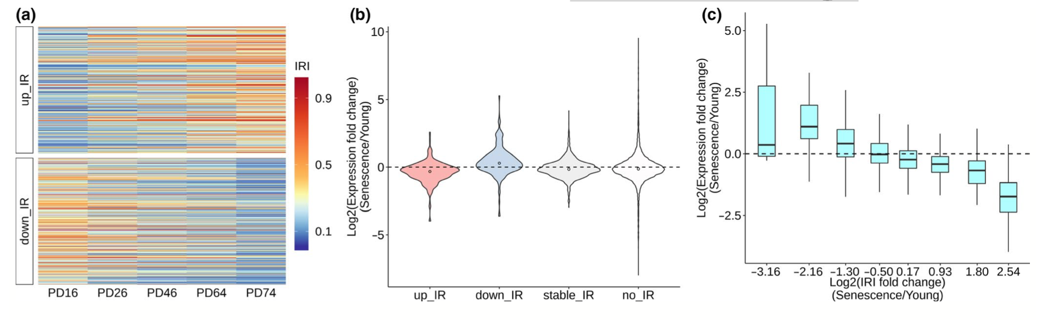
结果
03
Figure 1
IRI: 0.1, retained introns were discovered in about one thirds (3,180/9,040) of the expressed genes
知行合一、经世致用
自强不息 厚德载物
Central South University
Notes:
(RNA-seq) data consisting of five different time points, each has three biological replicates

Slide 9
结果
03
Figure 1
882 IR events showing continuously increased (up_IR, including 443 introns belong to 368 genes) or decreased (down_IR, including 439 introns belong to 333 genes) IRI
change_IR: 685 genes
知行合一、经世致用
自强不息 厚德载物
Central South University
Notes:
These continuously changed IR (up_IR +down_IR) were probably regulated by some factors important for senescence, and we thus defined them as regulated IR (change_IR, in 685 genes).
These results indicate the prevalence of IR during cellular senescence.

Slide 10
结果
03
Figure 1
gene FC between senescent (PD74) and young (PD16)
IR_up -> decreased gene expression trend IR_down -> increased gene expression trend
IRI increase degree was linearly correlated with the extent of decreased gene expression
知行合一、经世致用
自强不息 厚德载物
Central South University
Notes:
changes of IR during senescence may fine-tune gene expression and negatively correlate with gene expression senescence

Slide 11
结果
03
change_IR compared to stable_IR using Wilcoxon's test
significantly higher GC content (p = 0.026)
shorter length (p = 0.017)
weaker 3ʹ splicing strength (p = 0.032)
知行合一、经世致用
自强不息 厚德载物
Central South University
Notes:
为什么某些内含子被保留，接下来作者根据内含子的序列差异和 RBP 结合特性解释 IR 调控
Wilcoxons: 维克松

Slide 12
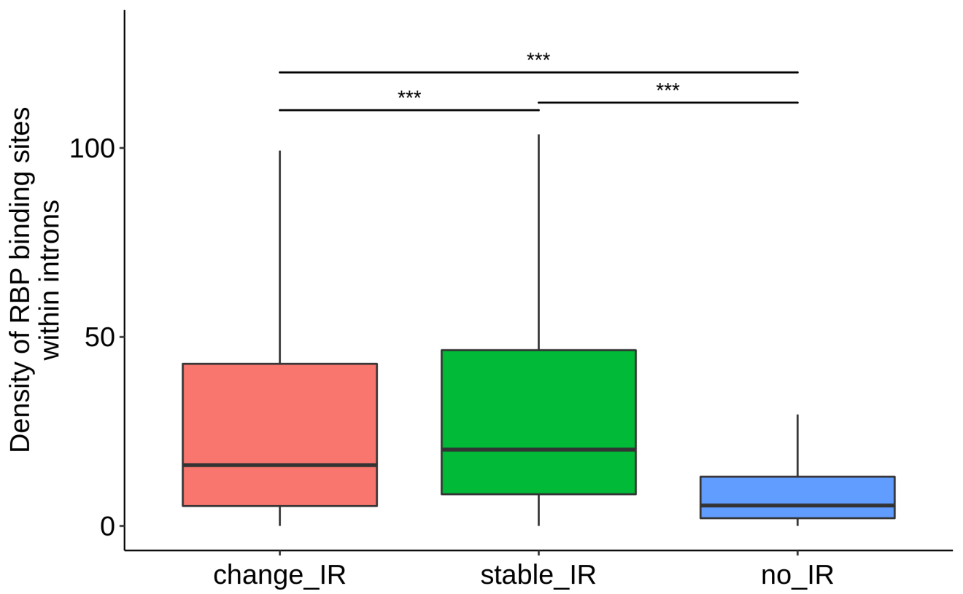
结果
03
change_IR and stable_IR had higher RBP-binding density than no_IR
RBP-binding density of change_IR was significantly lower than stable_IR, implying that the splicing efficiency of change_IR is more sensitive to RBP expression changes during senescence.
POSTAR2 database
Supplement Figure
知行合一、经世致用
自强不息 厚德载物
Central South University
Notes:
Genomic coordinates of 171 RBP-binding sites （intron-located-binding sites） based on experimental evidences were downloaded from the POSTAR2 database
experimentally identified by Clip: 交联-免疫沉淀法（CLIP）是让活体细胞被暴露在紫外灯下，使得RNA-蛋白结合起来并且可以用免疫共沉淀的方法使特异性的蛋白(这里即RBP)以及与其结合RNA一同被分离出来。

Slide 13
结果
03
As some RBPs (such as HNRNPLL and PTBP1) were reported to regulate IR
screened for candidate RBPs:
significantly higher binding density of this RBP in retained introns compared to spliced introns in both in vitro senescence models (HFF and MRC-5) and in vivo samples (dermal fibroblasts derived from young and aged healthy individuals)
gene expression level is significantly different between earlier and later passaged cells in at least two out of six senescence models (HFF, MRC-5, dermal fibroblasts, BJ, IMR90, and WI38)
gene expression level is larger than 10 RPKM (reads per kilobase million in RNA-seq) in at least one of the HFF cell passages.
知行合一、经世致用
自强不息 厚德载物
Central South University
Notes:
作者想知道某些RBP（s）表达的动态变化是否也能解释衰老过程中受调控的IR事件。
Models就是不同数据集：five population doubling (PD) time points for both HFF and MRC-5 cells; two PD time points for BJ, WI-38, and IMR-90 cells
筛选标准和数据集耦合

Slide 14
结果
03
Final obtained 15 RBPs
Hypothesis: If downregulation of a candidate RBP regulates senescence-related IR events, senescence-associated phenotypes would be expected upon knock-down (KD) of such RBP.
Selected RBPs: SRSF1, U2AF1 and U2AF2 (reported associating with senescence-associated phenotypes)
知行合一、经世致用
自强不息 厚德载物
Central South University
Notes:
15个RBP中大多数RBP在衰老过程中表达降低，作者假设：如果候选RBP的下调能调控衰老相关的IR事件，那么在这种RBP被敲除（KD）后将能发现衰老相关的表型。

Slide 15
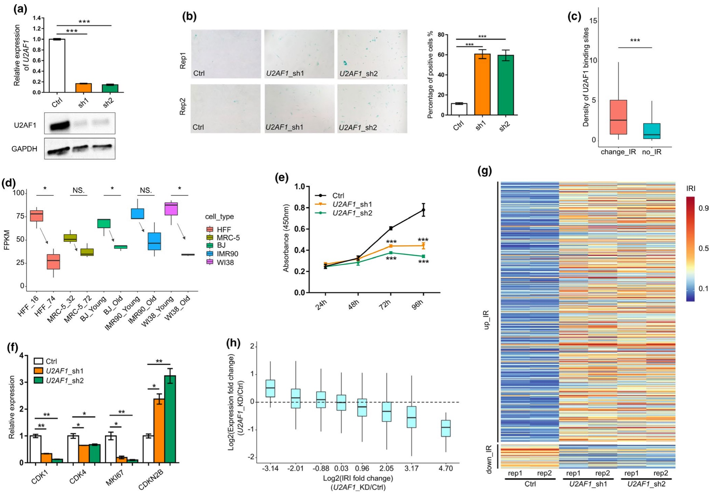
结果
03
SA-β-Ga
U2AF1
U2AF1
Figure 2
知行合一、经世致用
自强不息 厚德载物
Central South University
Notes:
经典的衰老相关标志物 SA-β-Gal 用于评估敲除候选 RBPs 的致衰老作用，结果表明剪接因子 U2AF1 的敲除诱导更高的 SA-β-Gal (shRNA:沉默RBP的表达)
*, **, and *** denote p < 0.05, p < 0.01, p < 0.001, respectively,
（a）(b)(c)（e） HFF数据集 (d) U2AF1表达减少
（e）增殖率，敲除U2AF1 导致细胞生长速度减慢

Slide 16
结果
03
Figure 2
知行合一、经世致用
自强不息 厚德载物
Central South University
Notes:
（g）IRI增加的内含子数量(up_IR)远远超过IRI减少的内含子(down_IR)
(f) MKI67,CDK1 ,CDK4基因 (细胞增殖有关)，CDKN2B基因(细胞增殖抑制剂）
（h）IRI 增加程度与基因表达降低的程度呈线性相关
U2AF1 的下调确实会诱导 细胞衰老

Slide 17
结果
03
candidate genes with following criteria:
It has altered IR both during U2AF1-KD-induced senescence and replicative senescence
its intron retention level (IRI) was significantly changed upon U2AF1-KD, and its expression was negatively correlated with IRI change
U2AF1 had binding peaks (supported by eCLIP data recorded in POSTAR2) in IRI-changed introns or flanking exons.
Six genes met all the above criteria:
CPNE1, EIF4A2 , PHYKPL, FANCL, IFFO1, RBM4B
知行合一、经世致用
自强不息 厚德载物
Central South University
Notes:
为了确定U2AF1介导的IR对衰老的因果作用，作者在U2AF1敲除之后筛选了具有显著IR变化的候选基因
(1) 衰老样本中IR水平会改变。

Slide 18
结果
03
知行合一、经世致用
自强不息 厚德载物
Central South University

Slide 19
结果
03
candidate genes with following criteria:
It has altered IR both during U2AF1-KD-induced senescence and replicative senescence
its intron retention level (IRI) was significantly changed upon U2AF1-KD, and its expression was negatively correlated with IRI change
U2AF1 had binding peaks (supported by eCLIP data recorded in POSTAR2) in IRI-changed introns or flanking exons.
Six genes met all the above criteria:
CPNE1, EIF4A2 , PHYKPL, FANCL, IFFO1, RBM4B
知行合一、经世致用
自强不息 厚德载物
Central South University
Notes:
由于CPNE1是IRI变化最为显著的基因，因此作者选择此基因进一步研究

Slide 20
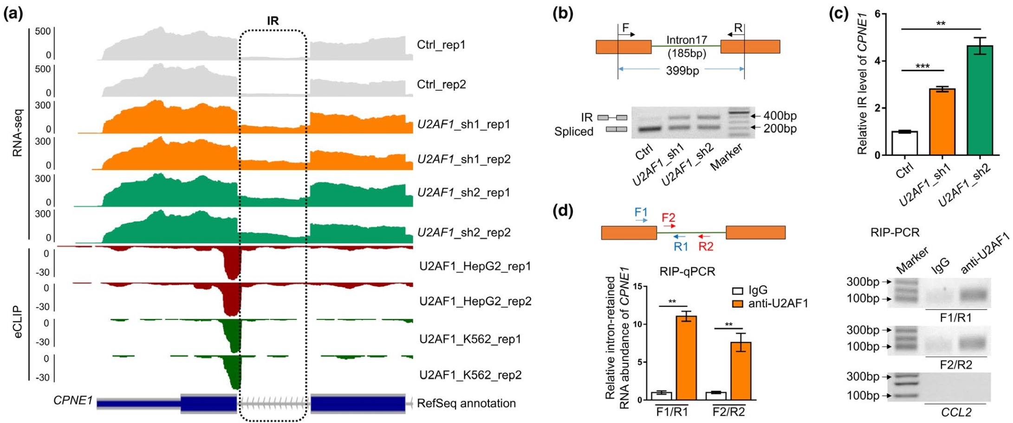
结果
03
Figure 3
知行合一、经世致用
自强不息 厚德载物
Central South University
Notes:
（a）last intron of CPNE1 , cell lines HepG2 and K562: U2AF1 knockdown
（b）RT-PCR (c) qRT-PCR 结果表明U2AF1-KD的细胞会使CPNE1基因的内含子保留水平增加
（d）RIP-qPCR，Primers (F1-R1; F2-R2)， lgG是control，CCL2是引物control

Slide 21
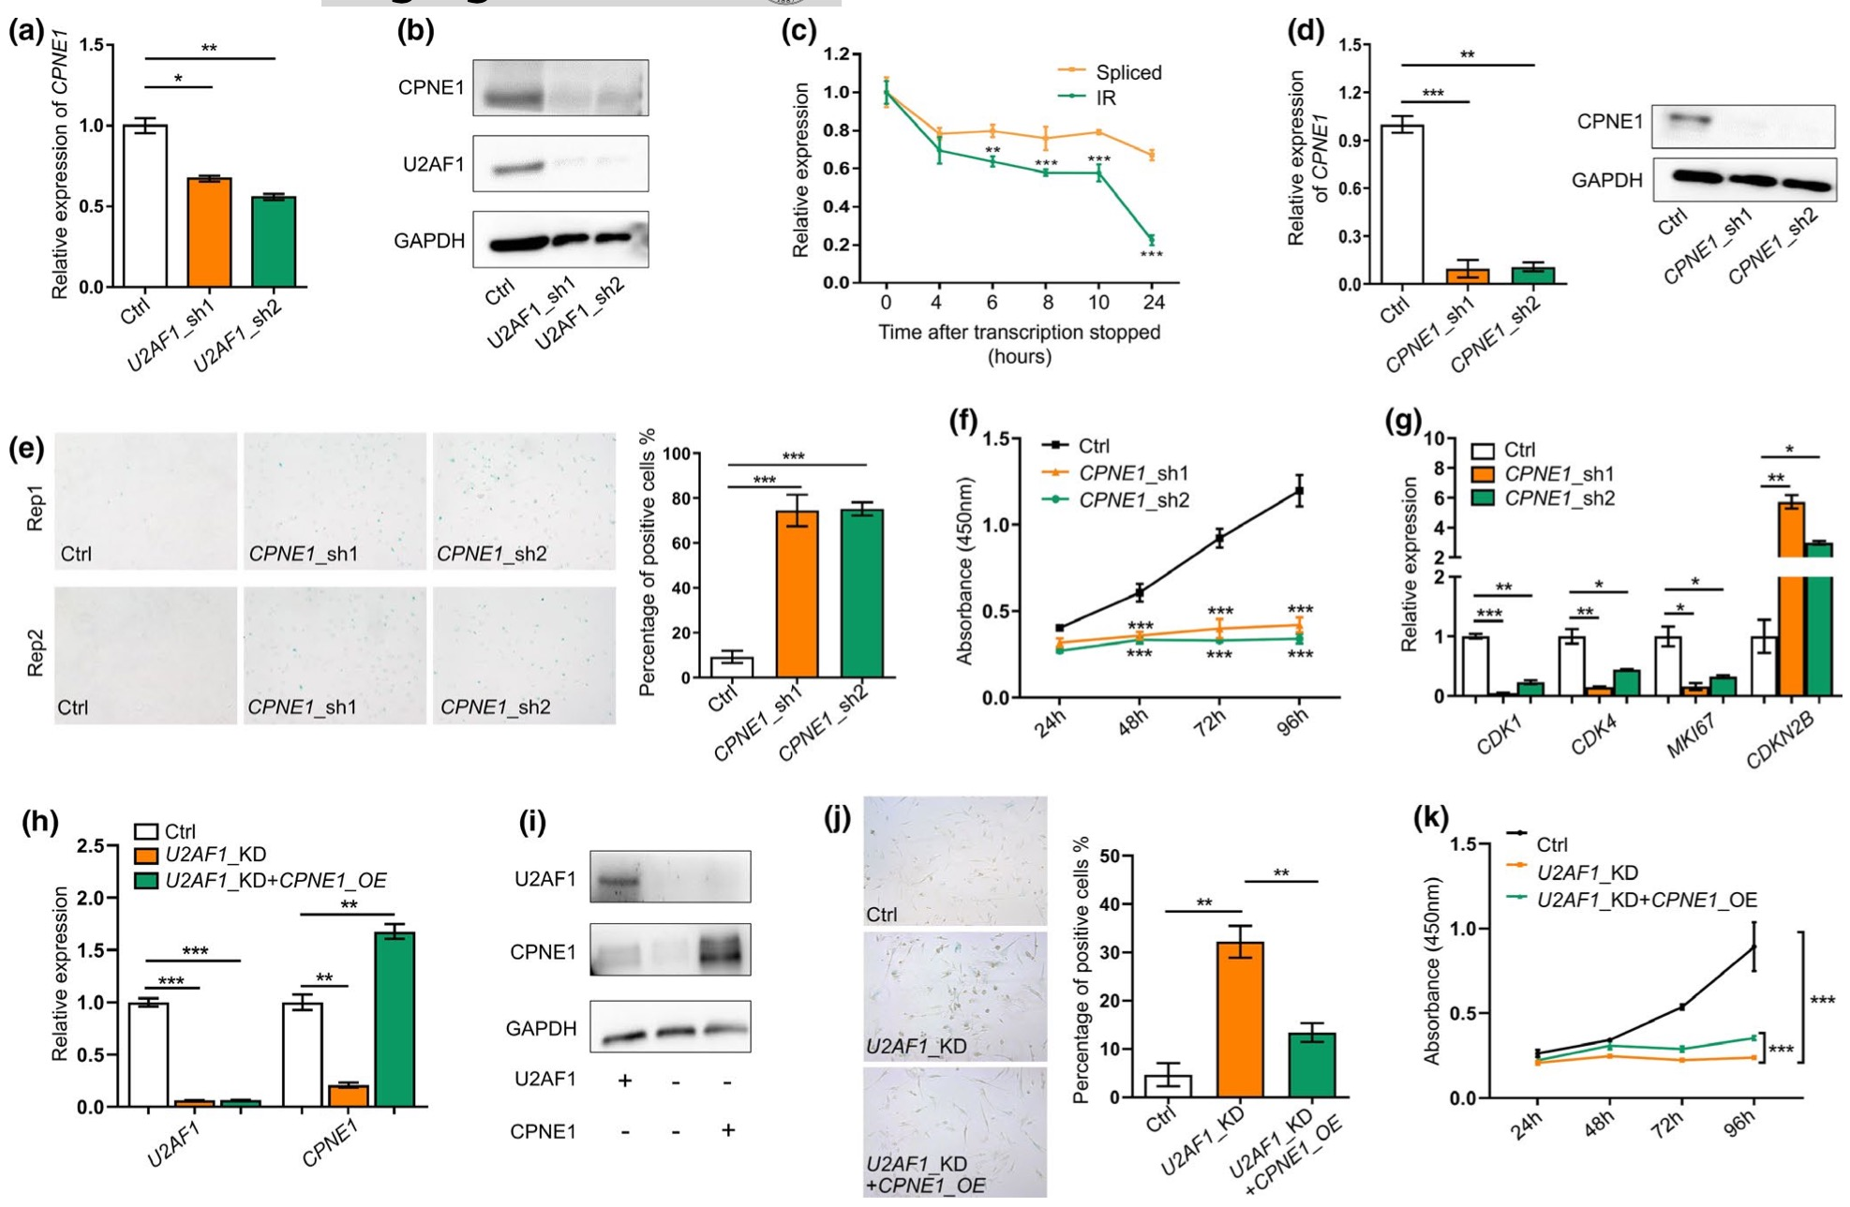
结果
03
Figure 4
U2AF1-KD cells decreased expression of CPNE1 (Figures 4a) and reduced CPNE1 protein level (Figure 4b)
IR transcripts of CPNE1 had a significantly higher degradation rate than the spliced ones (Fig 4c)
知行合一、经世致用
自强不息 厚德载物
Central South University
Notes:
（a） qRT-PCR （b）Western blot，蛋白质印迹
（c）CPNE1的IR转录本的降解率明显高于剪接转录本
（d）由于U2AF1的下调导致细胞中内含子保留增加和CPNE1表达减少，敲除CPNE1以模拟CPNE1中IR的结果（图4d），然后分析衰老相关表型以评估CPNE1中IR对衰老的贡献。

Slide 22
结果
03
Figure 4
(h) U2AF1 and CPNE1 gene expression, OE(overexpression)
知行合一、经世致用
自强不息 厚德载物
Central South University
Notes:
在CPNE1-KD 细胞中观察到 SA-β-Gal 标志物增加（e）和细胞增殖率（f）显着降低
（g）MKI67,CDK1 ,CDK4基因 (细胞增殖有关)，CDKN2B基因(细胞增殖抑制剂）(i) Protein level of U2AF1 and CPNE1 detected by Western blot before and after CPNE1-OE
(j)(k) CPNE1与衰老有关，过表达会使​​SA-β-Gal 标志物会降低和细胞增殖率增加,相比于U2AF1_KD
结果表明U2AF1_KD诱导的CPNE1内含子保留对细胞衰老有贡献。

Slide 23
总结
04
the intron retention levels dynamically changed and increased IR contributed to reduced gene expression
identified the splicing factor U2AF1 as one of the upstream factors to regulate global intron retention and senescence-associated phenotypes.
U2AF1-KD-induced IR of CPNE1 contributing to senescence was experimentally confirmed
知行合一、经世致用
自强不息 厚德载物
Central South University

Slide 24

谢 谢 大 家
THANKS FOR ALL

